Slide 1
Schedules and Loadshapes
This section will introduce you to the loadshape and schedule objects.

Slide 2
Schedule Object
Implemented in the core
One of two primary ways of inputting data (other is players)
Represent a recurring pattern of values over time
  Minutes, hours, days, weeks, months

Slide 3
Schedules (cont.)
Define when a value is used
  “mmm hhh DDD MMM WWW xxx”
  Sunday is day 0 and 7
  Holidays are day 8
Format of time specification: POSIX standard
  (similar to crontab format in UNIX)
  * 12 * * * noon every day
  * 12-15 * 1-4 * noon to 3pm Jan thru Apr
  * 15;18-5 * * 1-5 M-F 3pm and 6pm to 5am
Schedules blocks basis for normalization
Schedules blocks must be full (no gaps in time)
Size limitation of 63 nonzero unique values per block
Max number of 4 blocks

Slide 4
Schedule Implementation
There are two ways to use schedules
  Schedule transforms – uses a linear transformation to drive a object property from the current value of the schedule
  Loadshapes – uses a schedule to alter the energy or power parameter of a loadshape

Slide 5
Schedule Transforms
Works similar to targeting a player to an object property
Example:
Object house {
cooling_setpoint schedule_name*x+y;
}
Valid transforms are multiplication, addition, and subtraction.

Slide 6
Load shapes
NEW
Property – loadshape
  Associated with schedule
  4 types
    Analog
    Pulsed
    Modulated
    Queued
    Scheduled

Slide 7
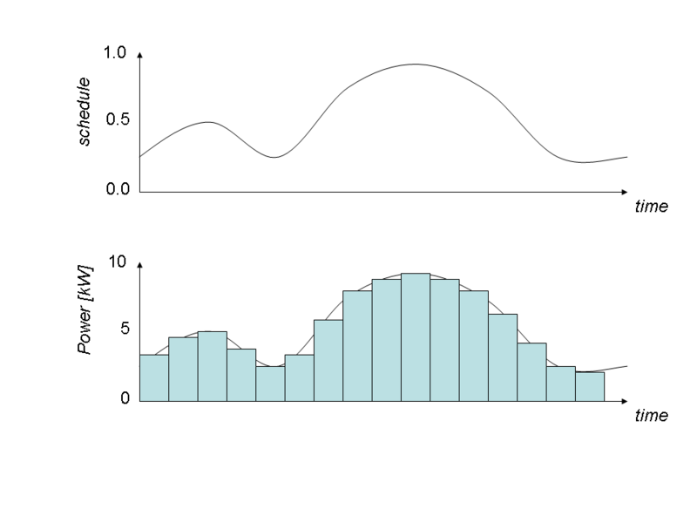
Analog Loadshapes
Analog loadshapes directly compute the power from the values in the schedule. An analog loadshape is defined using the following terms
class example {
loadshape myshape;
}
object fixed-energy {
myshape "type: analog; schedule: schedule-name; energy: value kWh";
}
object scaled-power {
myshape "type: analog; schedule: schedule-name; power: value kW";
}
object unscaled {
myshape "type: analog; schedule: schedule-name";
}

Slide 8
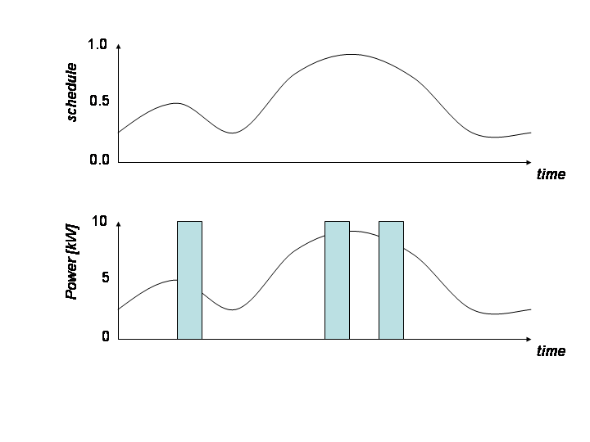
Pulsed
Pulsed loadshapes emit 1 or more pulses at random times such that the total energy is accumulated over the period of the loadshape. A pulsed loadshape is defined using the following terms:
class example {
loadshape myshape;
}
object sample {
myshape "type: pulsed; schedule: schedule-name; energy: value kWh; count: value; duration: value s";
}
class example {
loadshape myshape;
}
object sample {
myshape "type: pulsed; schedule: schedule-name; energy: value kWh; count: value; power: value kW";
}

Slide 9
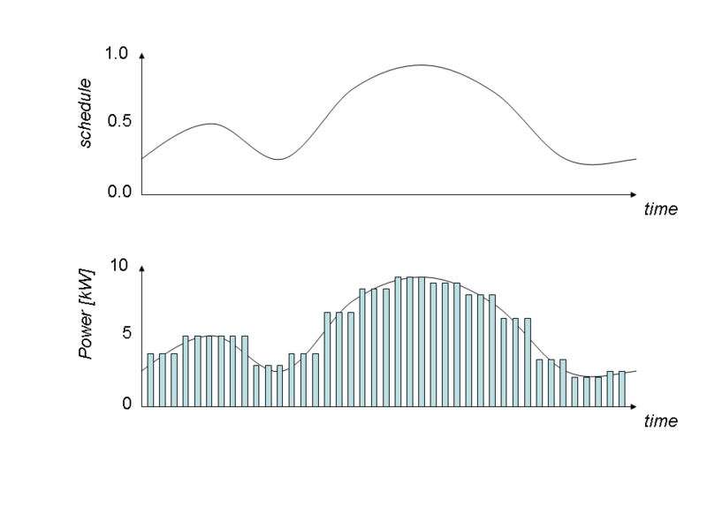
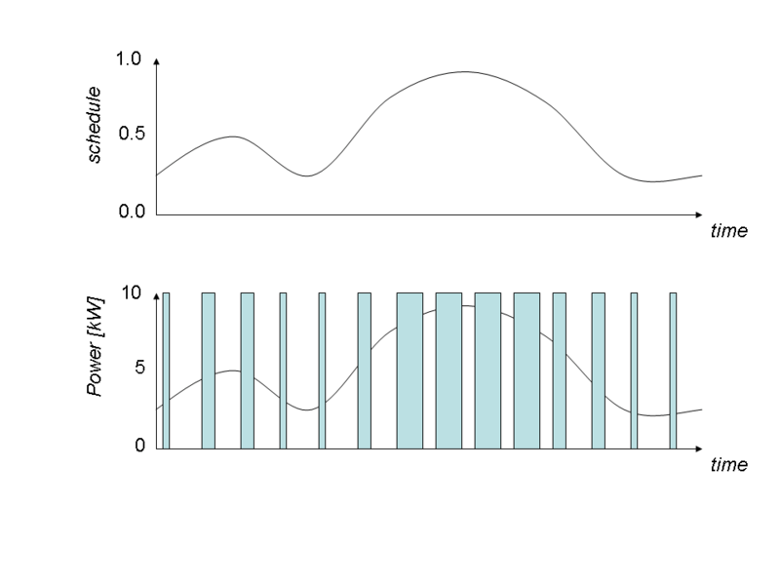
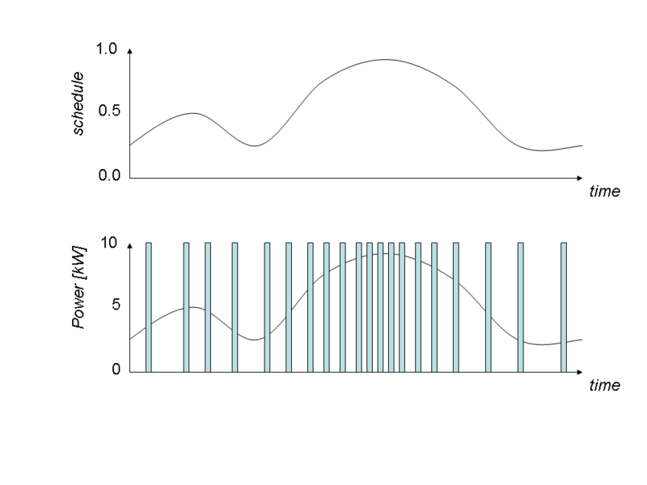
Modulated Loadshapes
Modulated loadshapes emit a continuous sequence of modulated pulses with either constant period and duty-cycle(amplitude), or constant power and on-time (pulsewidth), or constant power and period (frequency). A modulated loadshape is defined using the following terms:
class example {
loadshape myshape;
}
object sample {
myshape "type: modulated; modulation: modulation; schedule: schedule-name; energy: value kWh; count: value; period: value s";
}
class example {
loadshape myshape;
}
object sample {
myshape "type: modulated; modulation: modulation; schedule: schedule-name; energy: value kWh; count: value; power: value kW";
}

Slide 10
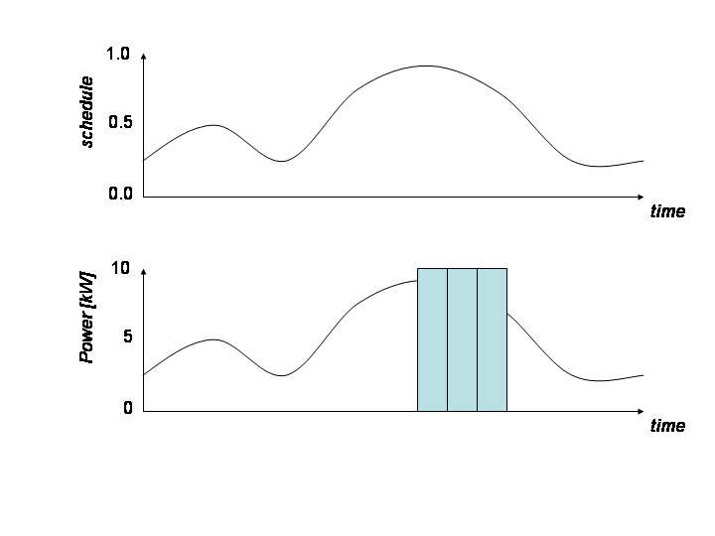
Queued Loadshapes
Queued loadshapes emit random pulses whenever a queue accrued from the loadshape reaches an on threshold and continues emitting pulses until the queue reaches an off threshold. A queued loadshape is defined using the following terms:
class example {
loadshape myshape;
}
object sample {
myshape "type: pulsed; schedule: schedule-name; energy: value kWh; count: value; duration: value s; q_on: value; q_off: value";
}
class example {
loadshape myshape;
} object sample {
myshape "type: pulsed; schedule: schedule-name; energy: value kWh; count: value; power: value kW; q_on: value; q_off: value";
}

Slide 11
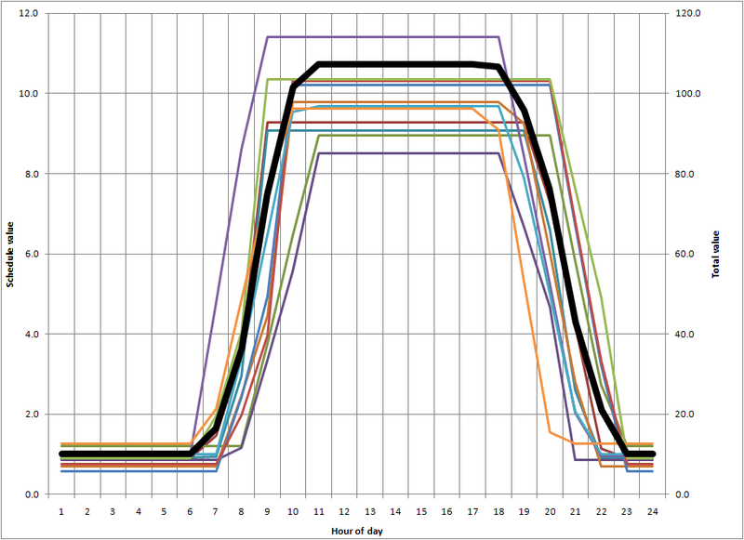
Scheduled Loadshapes
A schedule-based loadshape syntax available from Version 2.1 on has a number of important advantages.
The definition syntax of the schedule is simpler and more intuitive.
The definition incorporates diversity characteristics that are common in populations of buildings.
The example below will generate a randomized ramped 8 hour pulse at roughly 10 kW Monday through Friday
class example {
loadshape myshape;
}
object sample {
myshape "type: scheduled; weekdays: MTWRF; on-time: 6<8~1<10; off-time: 15<16~1<18; on-ramp: 0.5<1~0.5<1.5; off-ramp: 1<2~1<3; low: 1<2~1<3high: 10<15~2<20 kW”;
}

Slide 12
Demo
// This demo uses a schedule for
// a plugload object and records the power demand and energy used
// by the object.
module tape;
module residential{
implicit_enduses NONE;
}
clock {
timezone PST+8PDT;
starttime '2001-01-01 00:00:00';
stoptime '2001-01-02 00:00:00';
}
schedule plug_shape {
* 0-2 * * * 0.15;
* 3-5 * * * 0.35;
* 6-8 * * * 0.70;
* 9-17 * * * 0.500;
* 18-20 * * * 0.86;
* 21-23 * * * 0.25;
}
object house{
object plugload{
shape "type: analog; schedule: plug_shape; power: 1kW";
object recorder{
property power,demand,energy;
interval 3600;
limit 24;
file plugload_energy _usage.csv;
};
power_factor 1.0;
power_fraction 1.0;
current_fraction 0.0;
impedance_fraction 0.0;
};
};

Slide 13
Enduse
Property enduse
  Determines how a load or demand is converted to a power, accumulated to an energy and heat gain.
    Updated using loadshape
    Driven externally

Slide 14
Exercises
Define a house with this load shape and record the house plug load.
Define a second house with the same plug load shape but make it pulsed
W
750
500
250
0
0
3
6
9
12
15
18
21
24
hr

Slide 15
Exercises
Attach a pulsed loadshape to a waterheater object so that the loadshape affects the water_demand property and not the power demand property.

